Slide 1

ASSET INFORMATION IS ESSENTIAL FOR ANY TYPE OF ORGANIZATION AND BUSINESS FROM INFORMATION THEORY TO INFORMATION SECURITY

Slide 2
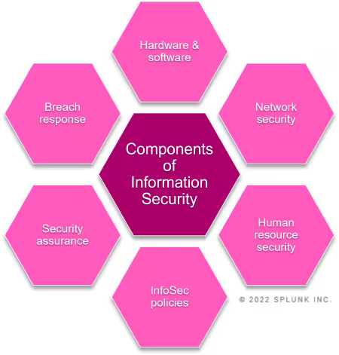
Information security-(InfoSec) general consideration
is a set of security procedures and tools that broadly protect sensitive enterprise information from misuse, unauthorized access, disruption, or destruction.
Notes:
Securitatea informațiilor (InfoSec), este un set de proceduri și instrumente de securitate care protejează în linii mari informațiile sensibile ale întreprinderii împotriva utilizării greșite, accesului neautorizat, întreruperii sau distrugerii.

Slide 3
pillars of INFOSEC
Confidentiality
Privacy is a major component of InfoSec, and organizations should enact measures that allow only authorized users access to information. Data encryption, multi-factor authentication, and data loss prevention are some of the tools enterprises can employ to help ensure data confidentiality.
Integrity
Enterprises must maintain data’s integrity across its entire lifecycle. Enterprises with strong InfoSec will recognize the importance of accurate, reliable data, and permit no unauthorized user to access, alter, or otherwise interfere with it. Tools like file permissions, identity management, and user access controls help ensure data integrity.
Availability
InfoSec involves consistently maintaining physical hardware and regularly completing system upgrades to guarantee that authorized users have dependable, consistent access to data as they need it.

Slide 4

Confidentiality OF INFORMATION
When information is read or copied by someone not authorized to do so, the result is known as loss of confidentiality.
Confidentiality is a principle that determines who has access to certain information, and how it can be shared.
The idea behind confidentiality is that sensitive and personal information should remain private unless the owner of that information wishes to disclose it.
For some types of information, confidentiality is a very important attribute. Examples include research data, medical and insurance records, new product specifications, and corporate investment strategies.
In some locations, there may be a legal obligation to protect the privacy of individuals.
This is particularly true for banks and loan companies; debt collectors; businesses that extend credit to their customers or issue credit cards; hospitals, doctors’ offices, and medical testing laboratories; individuals or agencies that offer services such as psychological counseling or drug treatment; and agencies that collect taxes
Notes:
Când informațiile sunt citite sau copiate de o persoană neautorizată în acest sens, rezultatul este cunoscut sub numele de pierderea confidențialității.
Confidențialitatea este un principiu care determină cine are acces la anumite informații și cum pot fi partajate.Ideea din spatele confidențialității este că informațiile sensibile și personale ar trebui să rămână private, cu excepția cazului în care proprietarul acestor informații dorește să le dezvăluie.
Pentru unele tipuri de informații, confidențialitatea este un atribut foarte important.
Exemplele includ date de cercetare, dosare medicale și de asigurări, specificații de produse noi și strategii de investiții corporative.
îN unele locații, poate exista o obligație legală de a proteja confidențialitatea persoanelor.Acest lucru este valabil mai ales pentru bănci și companii de creditare; colectori de datorii; companii care acordă credit clienților lor sau emit carduri de credit; spitale, cabinete medicale și laboratoare de analize medicale; persoane sau agenții care oferă servicii precum consiliere psihologică sau tratament pentru droguri; și agenții care colectează taxe

Slide 5
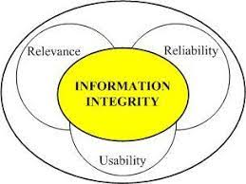
INTEGRITY OF INFORMATION
When information is modified in unexpected ways, the result is known as loss of integrity.
This means that unauthorized changes are made to information, whether by human error or intentional tampering.
Integrity is particularly important for critical safety and financial data used for activities such as electronic funds transfers, air traffic control, and financial accounting.

Slide 6
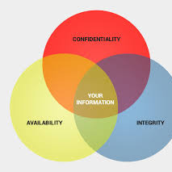
Availability OF INFORMATION
Information can be erased or become inaccessible, resulting in loss of availability.
The ability to make information and related physical and logical resources accessible as needed, when they are needed, and where they are needed.
This means that people who are authorized to get information cannot get what they need.
Availability is often the most important attribute in service-oriented businesses that depend on information (for example, airline schedules and online inventory systems).
Availability of the network itself is important to anyone whose business or education relies on a network connection.
When users cannot access the network or specific services provided on the network, they experience a denial of service.
Notes:
Informațiile pot fi șterse sau devin inaccesibile, ceea ce duce la pierderea disponibilității.
Aceasta înseamnă că persoanele care sunt autorizate să obțină informații nu pot obține ceea ce au nevoie.
Disponibilitatea este adesea cel mai important atribut în afacerile orientate spre servicii care depind de informații (de exemplu, orarele companiilor aeriene și sistemele de inventar online).
Disponibilitatea rețelei în sine este importantă pentru oricine a cărui afacere sau educație se bazează pe o conexiune la rețea.
Atunci când utilizatorii nu pot accesa rețeaua sau anumite servicii furnizate în rețea, se confruntă cu o refuzare a serviciului.

Slide 7
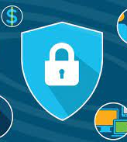
Key elements of information security
InfoSec comprises a range of security tools, solutions and processes that keep enterprise information secure across the personnel, devices and locations, helping to protect against cyberattacks or other disruptive events.
Notes:
Elemente cheie ale securității informațiilor
InfoSec cuprinde o serie de instrumente de securitate, soluții și procese care mențin informațiile companiei în siguranță pe dispozitive și locații, ajutând la protejarea împotriva atacurilor cibernetice sau a altor evenimente perturbatoare.

Slide 8

information security threats- specific for personnel
1. information theft
2. unauthorized dissemination of information
3. dissemination of information in ignorance
4. intentional destruction of information
5. involuntary destruction of information
…………………………….
Insider threats: An insider threat occurs when individuals close to an organization who have authorized access to its network intentionally or unintentionally misuse that access to negatively affect the organization's critical data or systems.

Slide 9
information security threats- specific for locations
1. placing documents in unsecured rooms – theft
2. lack of protection against fires, floods, destruction of materials containing documents
3. damage to documents due to faulty archiving
………………………………

Slide 10
The security of the applications on the device where the information is processed
Application security
Policies, procedures, tools, and best practices enacted to protect applications and their data.
Cloud security
Policies, procedures, tools, and best practices enacted to protect all aspects of the cloud, including systems, data, applications, and infrastructure.
Cryptography
An algorithm-based method of securing communication meant to ensure only intended recipients of a specific message can view and decipher it.
Disaster recovery
A method to reestablish functional technological systems in the wake of an event like a natural disaster, cyberattack, or another disruptive event.
Notes:
Securitatea aplicației
Politici, proceduri, instrumente și cele mai bune practici adoptate pentru a proteja aplicațiile și datele acestora.Securitate în cloudPolitici, proceduri, instrumente și cele mai bune practici adoptate pentru a proteja toate aspectele cloud-ului, inclusiv sistemele, datele, aplicațiile și infrastructura.Securitate în cloudCriptografieO metodă bazată pe algoritm de securizare a comunicării menită să se asigure că numai destinatarii vizați ai unui anumit mesaj îl pot vizualiza și descifra.Recuperare în caz de dezastruO metodă de restabilire a sistemelor tehnologice funcționale în urma unui eveniment cum ar fi un dezastru natural, un atac cibernetic sau un alt eveniment perturbator.

Slide 11
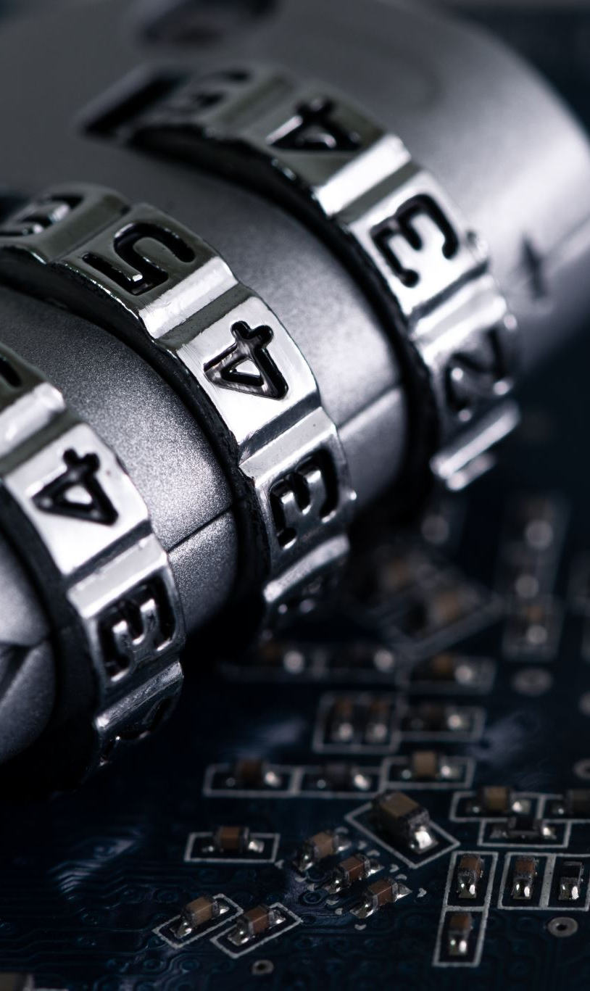
information security threats- specific for device where the information is processed www.microsoft.com
Advanced persistent threat (APT) attack: A sophisticated cyberattack occurring over a prolonged period, during which an undetected attacker (or group) gains access to an enterprise’s network and data.
Botnet: Derived from the term “robot network,” a botnet comprises a network of connected devices an attacker infects with malicious code and controls remotely.
Distributed denial-of-service (DDoS) attack: DDoS attacks utilize botnets to overwhelm an organization’s website or application, resulting in a crash or a denial of service to valid users or visitors.
Drive-by download attack: A malicious piece of code that automatically downloads onto a user’s device upon visiting a website, making that user vulnerable to further security threats.

Slide 12
information security threats- specific for device where the information is processed www.microsoft.com
Exploit kit: A comprehensive set of tools that utilize exploits to detect vulnerabilities and infect devices with malware.
Insider threat: The possibility that an organizational insider will exploit authorized access, intentionally or not, and harm or make vulnerable the organization’s systems, networks, and data.
Man-in-the-middle (MitM) attack: A malicious attacker interrupts a line of communication or data transfer, impersonating a valid user, in order to steal information or data.
Phishing attack: Phishing attacks impersonate legitimate organizations or users in order to steal information via email, text message, or other communication methods.
Ransomware: A malware extortion attack that encrypts an organization or person’s information, preventing access until a ransom is paid.
Social engineering: Cyberattacks that originate with human interaction, in which the attacker gains a victim’s trust through baiting, scareware, or phishing, gathers personal information, and utilizes the information to carry out an attack.
Social media attack: Cyberattacks that target social media platforms, exploiting the platforms as delivery mechanisms, or stealing user information and data.
Viruses and worms: Malicious, undetected malware that can self-replicate across a user’s network or system.

Slide 13
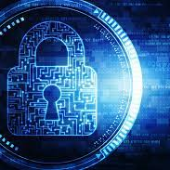
Information security in organization
Enterprises can employ information security management systems (ISMS) to standardize security controls across an organization, setting up custom or industry standards to help ensure InfoSec and risk management. Employing a systematic approach toward InfoSec will help proactively protect your organization from unnecessary risk and allow your team to efficiently remediate threats as they arise.

Slide 14
Responding to information security threats
Once security team has been altered to an InfoSec threat, complete the following steps:
Gather team and reference your incident response plan.
Identify the source of the threat.
Perform actions to contain and remediate the threat.
Evaluate any damage.
Notify relevant parties.

Slide 15
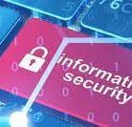
The security of the applications on the device where the information is processed
Incident response
An organization’s plan for responding to, remediating, and managing the aftermath of a cyberattack, data breach, or another disruptive event.
Infrastructure security
Security that encompasses an organization’s entire technological infrastructure, including both hardware and software systems.
Risk management
The process an organization takes to identify, assess, and remediate all vulnerabilities and threats (risks) in organization.

